Slide 1
Database Design

Slide 2
Chapter 5: Database Design T1: Page 337-373
Informal Design Guidelines for Relation Schemas
Functional Dependencies
Normal Forms Based on Primary Keys
General Definition of 2nd & 3rd Normal forms
Boyce-Codd Normal Form

Slide 3
Overview
Two levels to make relational database schema ‘good’:
Logical level: Database design
Physical level: Storage etc.
Database design may be performed using two approaches
Bottom-up design methodology (design by synthesis)
Top-down design methodology (design by analysis)

Slide 4
Informal Design Guidelines for Relation Schemas
Four informal measures are considered for relation schema design.
Semantics of the attributes
Reducing the redundant values in tuples.
Reducing the Null values in tuples.
Disallowing the possibility of generating spurious tuples.

Slide 5
1.Semantics of the relation attributes
Semantics specify the interpretation of the attribute values stored in a tuple of the relation .
Values of different attributes in a tuple of the relation should be related to each other.
For a better relation schema design, semantics of the relation should be easier to understand.

Slide 6
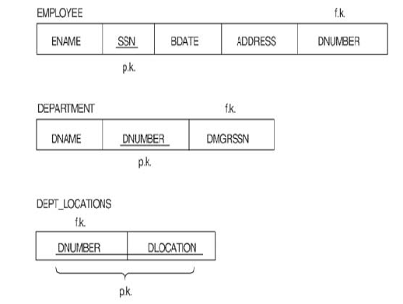
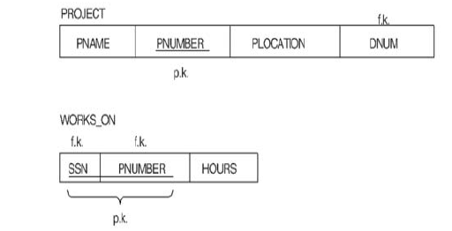
A Company Database

Slide 7
Guideline 1
Informally, each tuple in a relation should represent one entity or relationship instance.
Attributes of different entities (EMPLOYEEs, DEPARTMENTs, PROJECTs) should not be combined in the same relation
Only foreign keys should be used to refer to other entities
Entity and relationship attributes should be kept apart as much as possible.
Do not combine attributes from multiple entity types and relationship types into a single relation.

Slide 8
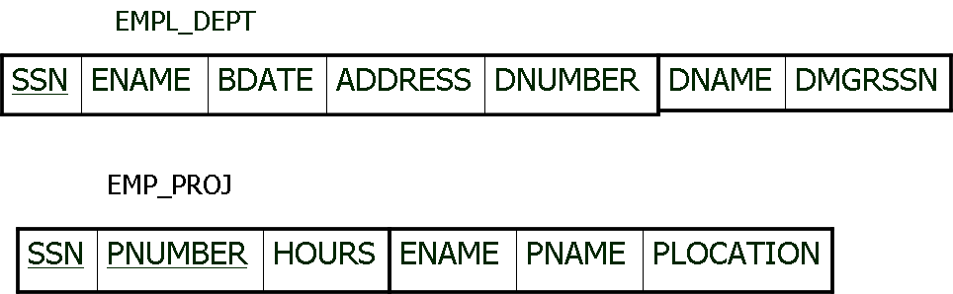
Poor Design

Slide 9
2. Redundant Information in Tuples and Update Anomalies
Good schema design minimizes the storage space used by the base tables.
Grouping attributes into relation schema has a significant effect on storage space.

Slide 10
Update anomalies
Update anomalies can be classified into following:
Insertion Anomalies
Deletion Anomalies
Modification (Update) Anomalies

Slide 11
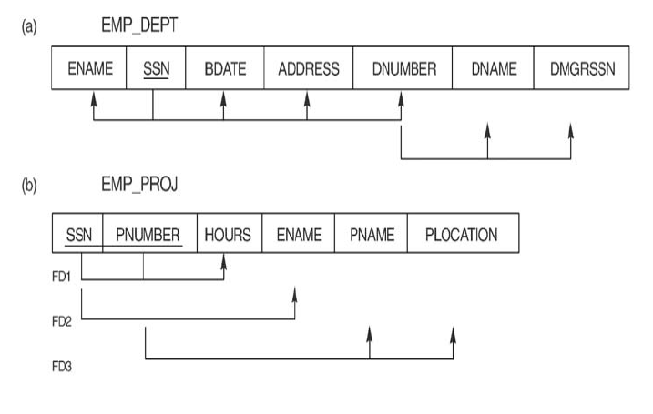
Poor Design

Slide 12
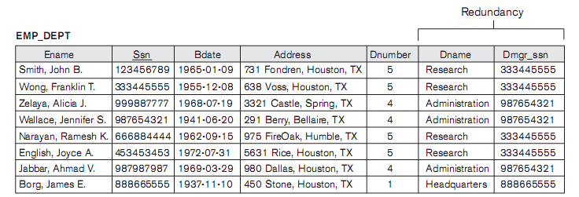
Poor Design

Slide 13
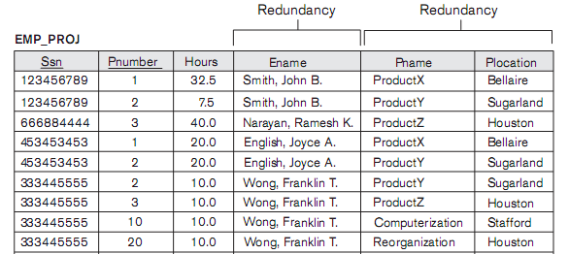
Poor Design

Slide 14
Insertion Anomalies
It may not be possible to store certain information unless some other, unrelated information is stored also.
e.g.
To insert a new employee tuple into EMP_DEPT, we must include attribute values for the department that the employee works for, or NULLS.
Inserting all the department attributes values along with each employee may lead to inconsistency.

Slide 15
Insertion Anomalies
Attributes of a new department can not be inserted if it has no employee yet.
Or
NULLS have to be inserted for attributes of employee but SSN being primary key can not be NULL.

Slide 16
Deletion Anomalies
It may not be possible to delete certain information without losing some other unrelated information is also deleted.
e.g.
If an employee tuple has to be deleted which happens to be last employee in a department, that department information will also be lost.

Slide 17
Modification Anomalies
If one copy of such repeated data is updated, an inconsistency is created unless all copies are similarly updated.
E.g.
If we change any attribute of the department, all the employee tuples should also be modified otherwise inconsistency will occur.

Slide 18
Guideline 2
Design a schema that does not suffer from any of the Update anomalies (insertion, deletion and update anomalies).
These guidelines sometimes have to be violated to improve the query performance.
If any anomalies are present, it should be handled by programs.
Instead of grouping attributes from different relations, views can be used to have such query where attributes from different relations can be displayed.

Slide 19
3. NULL values in Tuples
NULLS can have multiple interpretations:
The attribute does not apply to that particular tuple.
The attribute value for this tuple is unknown.
The value is known but not provided yet.
But representation for all above is same i.e. NULL.
Too many NULLS can waste space at the storage level.
Accounting NULLS in aggregate operations such as COUNT or SUM is difficult.

Slide 20
Guideline 3
Relations should be designed such that their tuples will have as few NULL values as possible
Attributes that are NULL frequently could be placed in separate relations (with the primary key)

Slide 21
NULL values in Tuples
E.g.
If only 10% employees have individual offices, it is not preferable to have attribute OFFICE_ADDRESS in employee relation because 90% employees will have NULL values for that attribute.
A relation EMP_OFFICE can be created having attribute SSN & OFFICE_ADDRESS.

Slide 22
4. Generation of Spurious Tuples
Additional tuples due to join operation will be generated which are wrong or have invalid information; these are called Spurious tuples.
The nonadditive ("lossless join") property is used to guarantee meaningful results for join operations

Slide 23
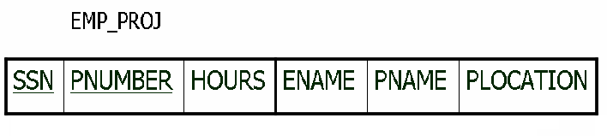
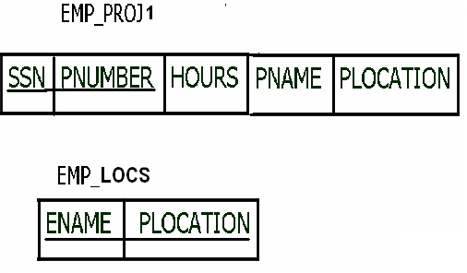
4. Generation of Spurious Tuples: Example
Natural join of EMP_PRJ1 and EMP_LOCS will give spurious tuples

Slide 24
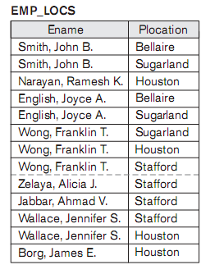

Slide 25
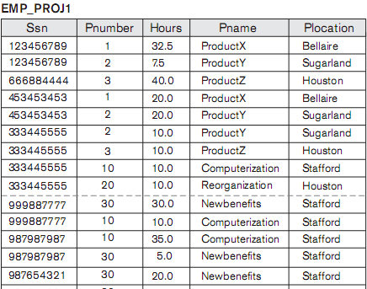

Slide 26
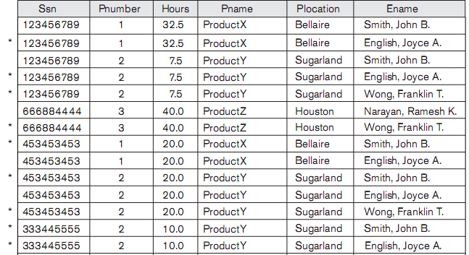
Natural Join

Slide 27
Guideline 4
The relations should be designed to satisfy the lossless join condition. No spurious tuples should be generated by doing a natural-join of any relations.
Design relation schema so that they can be joined with equality condition on attributes that are either Primary keys or foreign keys and guarantee no spurious tuples are generated.
Avoid relations that contain matching attributes which are not Primary keys or foreign keys combinations, because joining of such attributes may generate spurious tuples.

Slide 28
Design Guidelines: Summary
1. Do not combine attributes from multiple entity types relationship type into a single relation.
2. Anomalies that cause redundant work to be done during insertion and modification of a relation, and that may cause accidental loss of information during a deletion from a relation, should be avoided.

Slide 29
Design Guidelines: Summary
3. Waste of storage space due to nulls and difficulty of performing aggregation operations and joins due to null values.
4. Generation of invalid and spurious data during joins on improperly related base relations.

Slide 30
Functional Dependencies
Functional Dependency is a constraint between two sets of attributes from the database.
Definition:
A functional dependency, denoted by X → Y (between two sets of attributes X and Y that are subsets of R) specifies a constraint on the possible tuples for every state r of relation R.
The constraint is that, for any two tuples t1 and t2 in r that have t1[X]= t2[X], they must also have
t1[Y]=t2[Y].

Slide 31
Functional Dependencies
There is a functional dependency from X to Y
(or the value of Y is determined by the value of X (or X uniquely determines the value of Y)
(or Y is functionally dependent on X)
The abbreviation for functional dependency is FD or f.d.
The set of attributes X is called the left-hand side of the FD, and Y is called the right-hand side of the FD.

Slide 32
Functional Dependencies
If a constraint on R states that there cannot be more than one tuple with a given X value in any relation instance r(R) (that is, X is a candidate key of R), this implies that X → Y is true for any subset of attributes Y of R.
If X → Y in a R, this does not say whether or not
Y → X in R

Slide 33
Functional Dependencies
A functional dependency is the property of relation schema not of a particular state (r) of R.
Thus functional dependency is true for all the possible states of the relation.
Relation extensions that satisfy the functional dependency, are called legal relation states (or relation extensions).
An FD can not be inferred automatically from a given relational state but must be defined for the relation schema.

Slide 34
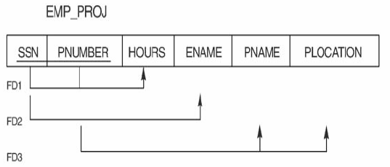
Functional Dependencies: Example
FD2: SSN → ENAME
FD3: PNUMBER → {PNAME, PLOCATION}
FD1: {SSN, PNUMBER} → HOURS
Set of all specified dependencies is denoted by F

Slide 35
Inferences Rules for functional dependencies
Designer specifies functional dependencies that are semantically obvious.
Formally, the set of all dependencies that include F as well as all dependencies that can be inferred from F (given set of dependencies) is called the closure of F and it is denoted by F+.

Slide 36
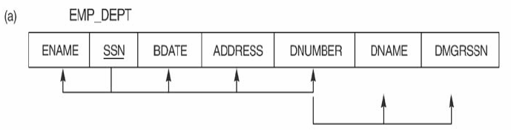
Inferences Rules for functional dependencies
e.g.
F = {SSN→{ENAME, BDATE, ADDRESS, DNUMBER}, DNUMBER→{DNAME,DMGRSSN}}
We can infer the following additional functional
dependencies from F:
SSN→ {DNAME,DMGRSSN}
SSN→SSN
DNUMBER→DNAME

Slide 37
Inferences Rules for functional dependencies
A set of inference rules can be applied to infer new dependencies from a given set of dependencies
F╞ X→Y denotes that functional dependency X→Y is inferred from the set of given functional dependencies F.
Armstrong's inference rules is a complete set of inference rules and can be applied to get closure of functional dependencies.

Slide 38
Inferences Rules for functional dependencies
Armstrong's inference rules:
IR1. (Reflexive rule) If Y is subset-of X, then X → Y
IR2. (Augmentation rule) If X → Y, then XZ → YZ
or X → Y ╞ XZ → YZ
IR3. (Transitive rule) If X→Y and Y→Z, then X→Z
or {X→Y, Y→Z} ╞ X→Z
IR1, IR2, IR3 form a sound and complete set of
inference rules

Slide 39
Inferences Rules for functional dependencies
The reflexive rule (IR1) states that a set of attributes always determine itself or any of its subsets
Because IR1 generates dependencies that are always true and are known as trivial.
The augmentation rule (IR2) states that adding the same set of attributes to both the left- and right-hand sides of a dependency results in another valid dependency.
The transitive rule (IR3) states that functional dependencies are transitive.

Slide 40
Inferences Rules for functional dependencies
Some additional useful inference rules:
IR4. (Decomposition) If X → YZ, then X → Y and X → Z
IR5. (Union) If X → Y and X → Z, then X → YZ
IR6. (Psuedotransitivity) If X → Y and WY → Z,
then WX → Z
The last three inference rules, as well as any other inference rules, can be deduced from IR1, IR2, and IR3 (completeness property)

Slide 41
Inferences Rules for functional dependencies
Decomposition rule (IR4) says that attributes from right-hand side can be removed and applying the rule repeatedly can decompose a FD into set of FDs.
Union (IR5) is opposite of IR4 i.e. set of FDs can be combined into a single FD
Psuedotransitivity (IR6) is similar to transitive.

Slide 42
Inferences Rules for functional dependencies
Derivation of IR4. (Decomposition)
X → YZ (given)
YZ → Y (using IR1)
X → Y (using IR3 on 1 & 2)

Slide 43
Inferences Rules for functional dependencies
Derivation of IR5. (Union)
X → Y (given)
X → Z (given)
X → XY (using IR2 on 1)
XY → YZ (using IR2 on 2)
X → YZ (using IR3 on 3 & 4)

Slide 44
Inferences Rules for functional dependencies
Derivation of IR6. (Psuedotransitivity)
X → Y (given)
WY → Z (given)
WX → WY (using IR2 on 1)
WX → Z (using IR3 on 3 & 2)

Slide 45
Inferences Rules for functional dependencies (Example)
Contracts (contractid, supplierid, projectid, deptid, partid, qty, value)
Schema is denoted for Contracts as CSJDPQV.
The meaning of a tuple in this relation is that the contract with contractid C is an agreement that supplier S (supplierid) will supply Q items of part P (partid) to project J (projectid) associated with department D (deptid); the value V of this contract is equal to value.

Slide 46
Inferences Rules for functional dependencies (Example)
The following FDs are known to hold:
The contract id C is a key: C → CSJDPQV.
A project purchases a given part using a single contract: JP → C.
A department purchases one part from a supplier: SD → P.

Slide 47
Inferences Rules for functional dependencies (Example)
Several additional FDs hold in the closure of the set of
given FDs:
From JP → C, C → CSJDPQV and transitivity,
we infer JP → CSJDPQV.
From SD → P and augmentation,
we infer SDJ → JP.

Slide 48
Inferences Rules for functional dependencies (Example)
From SDJ → JP, JP → CSJDPQV and transitivity, we infer SDJ → CSJDPQV.
We can infer several additional FDs that are in the closure by using augmentation or decomposition.
For example, from C → CSJDPQV, using decomposition we can infer:
C → C, C → S, C → J, C → D, etc.
Finally, we have a number of trivial FDs from the reflexivity rule.

Slide 49
Inferences Rules for functional dependencies
Closure of a set F of FDs is F+ that includes F as well as all dependencies that can be inferred from F
Closure of a set of attributes X with respect to F is the set X+ of all attributes that are functionally determined by X
X+ can be calculated by repeatedly applying IR1, IR2, IR3 using the FDs in F

Slide 50
Inferences Rules for functional dependencies
Given set of functional dependencies
SSN → ENAME
PNUMBER → {PNAME, PLOCATION}
{SSN, PNUMBER} → HOURS

Slide 51
Inferences Rules for functional dependencies
Closure sets with respect to F
{SSN}⁺ → {SSN, ENAME}
{PNUMBER}⁺ → {PNUMBER, PNAME, PLOCATION}
{SSN, PNUMBER}⁺ → {SSN, PNUMBER, ENAME, PNAME, PLOCATION, HOURS}

Slide 52
Computing the Closure of Attributes - Example
Let’s consider a relation with attributes A, B, C, D, E and F. Suppose that this relation satisfies the FD’s:
AB→C,
BC→AD,
D→E,
CF→B.
What is {A,B}⁺?
Iterations:
X = {A,B} Use: AB→C
X = {A,B,C} Use: BC→AD
X = {A,B,C,D} Use: D→E
X = {A,B,C,D,E} No more changes to X are possible so X = {A,B}⁺.

Slide 53
Closure of a Set of Attributes
Consider the relation scheme R(A,B,C,D) with functional dependencies {A}→{C} and {B}→{D}.
{A}+ = {A,C}
{B}+ = {B,D}
{C}+={C}
{D}+={D}
{A,B}+ = {A,B,C,D}

Slide 54
Equivalence of sets of functional dependencies
Equivalence of Sets of FDs
Two sets of FDs F and E are equivalent if:
Every FD in F can be inferred from E, and
Every FD in E can be inferred from F
Hence, F and E are equivalent if F+ =E+
Definition:
A set of functional dependencies F is said to cover another FD E, if every FD in E is also in F+, that is, if every dependency in E can be inferred from F, we say that E is covered by F.

Slide 55
Minimal Sets of functional dependencies
A set of FDs is minimal if it satisfies the following conditions:
(1) Every dependency in F has a single attribute for its RHS.
(2) We cannot replace any dependency X → A in F with a dependency Y → A, where Y proper-subset-of X and still have a set of dependencies that is equivalent to F.
(3) We cannot remove any dependency from F and have a set of dependencies that is equivalent to F.

Slide 56
Minimal Sets of functional dependencies
Every set of FDs has an equivalent minimal set
There can be several equivalent minimal sets
There is no simple algorithm for computing a minimal set of FDs
To synthesize a set of relations, we assume that we start with a set of dependencies that is a minimal set

Slide 57
Algorithm to find Minimal cover F for a set of functional dependencies E
Set F:=E
Replace each functional dependency
X → {A1, A2,……, An} in F by the n functional dependencies X → A1, X → A2, ….X → An.
For each functional dependency X→ A in F
for each attribute B that is an element of X
if {{F- {X→A}} U {(X- {B})→A} is equivalent to F,
then replace X → A with (X- {B}) → A in F.

Slide 58
Algorithm to find Minimal cover F for a set of functional dependencies E
For each remaining functional dependency X→A in F
if {{F- {X→A}} is equivalent to F
then remove X → A from F

Slide 59
Example to find Minimal cover
Given FDs E: {B → A, D → A, AB → D},
find minimal cover
Step1: given FDs are already in canonical form
Step2: can we replace AB → D with A→D and B→D?
Apply Augmentation rule on B→A
We get, BB → AB
Given is AB→D,
By transitivity rule B→D can be inferred
Thus AB→D can be replaced by B→D

Slide 60
Example to find Minimal cover
Given FDs E: {B → A, D → A, AB → D},
find minimal cover
Now E: {B→A, D→A, B→D}
Step3: B→A can be inferred by applying transitivity rule on B→D and D→A
Thus B→A is redundant and can be removed
Hence minimal cover is {B→D, D→A}

Slide 61
Normal Forms based on Primary Keys
If a set of functional dependencies is given for each relation and each relation has a designated primary key
Above information and tests for normal forms drives the normalization process for relational schema design.
For relational design two approaches are followed:
First perform conceptual design (ER or EER model) then map to set of relations.
Design the relations based on external knowledge (existing implementations, reports, forms etc.)

Slide 62
Normal Forms based on Primary Keys
Then we have to evaluate the relations for goodness and decompose them further and further as needed to achieve higher normal forms using normalization theory.
Normalization is carried out in practice so that the resulting designs are of high quality and meet the desirable properties.
The normalization process (proposed by Codd, 1972) takes a relation schema through a series of tests to certify whether it satisfies certain normal form.

Slide 63
Introduction to Normalization
Three normal forms were proposed by Codd (1972).
Normalization of data can be looked upon as a process of analyzing the given relation schemas based on their FDs and primary keys to achieve the desirable properties which are as follows:
Minimizing redundancy
Minimizing the insertion , deletion , and update anomalies

Slide 64
Introduction to Normalization
If unsatisfactory relation schemas don’t meet certain conditions i.e. the normal form test, these are decomposed into smaller relation schemas that meet the tests and hence posses the desirable properties .

Slide 65
Introduction to Normalization
Thus, the normalization procedure provides database designers with the following :
A formal frame work for analyzing relation schemas based on their keys and on the functional dependencies among their attributes.
A series of normal form tests that can be carried out on individual relation schemas so that relational database can be normalized to any desired degree

Slide 66
Introduction to Normalization
The normal form of a relation refers to the highest normal form condition that it meets and hence indicates the degree to which it has been normalized.
But normalization can not be considered in isolation for a good database design.
The process of normalization through decomposition must also confirm the existence of two additional properties that the relational schemas (together) should possess .

Slide 67
Introduction to Normalization
The lossless join or nonadditive join property
It guarantees that the spurious tuple generation problem does not occur with respect to the relation schemas created after decomposition.
It is extremely critical and must be achieved at any cost.
The dependency preservation property
It ensures that each functional dependency is represented in some individual relation resulting after decomposition.
Sometimes sacrificed for higher performance.

Slide 68
Practical Use of Normal Forms
Database design in industry today pays particular attention to normalization only up to 3NF, BCNF, 4NF.
Sometimes relations may be left in a lower normalization status, such as 2NF, for performance reasons.
The process of storing the join of higher normal form relations as a base relation – which is in a lower normal form – is known as denormalization.

Slide 69
Definitions of keys and Attributes Participating in keys
Superkey:
A superkey of a relation schema R= {A1, A2 …. An} is a set of attributes S subset-of R with a property that no two tuples t1 and t2 in any legal relation state r of R will have t1[S] = t2[S]
Key (minimal superkey):
A key K is a superkey with additional property that removal of any attribute from K will cause K not to be a superkey

Slide 70
Definitions of keys and Attributes Participating in keys
Candidate key:
If a relation schema has more than one key, each is called a candidate key.
One of the candidate key is designated as primary key, and others are called Secondary keys.
Each relation schema must have a primary key.

Slide 71
Definitions of keys and Attributes Participating in keys
An attribute of relation schema R is called a prime attribute of R if it is a member of some candidate key of R.
An attribute is called nonprime, if it is not a member of any candidate key.
For example:
SSN and PNUMBER are the prime attributes of the relation WORKS_ON whereas other attributes are non-prime.

Slide 72
First Normal Form
It states that the domain of an attribute must include only atomic (simple , indivisible ) values.
The value of any attribute in a tuple must be a single value from the domain of that attribute.
Hence, 1NF disallows having a set of values, a tuple of values, or a combination of both as an attribute value for a single tuple.
1NF disallows “relations within the relations”.

Slide 73
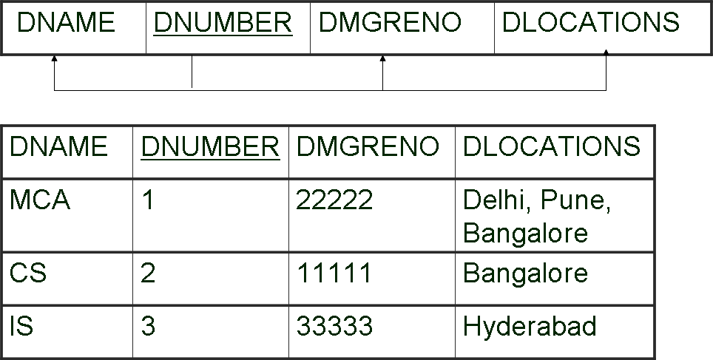
A relation schema which is not in 1 NF
There are three main techniques to achieve first normal form :

Slide 74
First Normal Form (first technique)
Remove the attribute DLOCATIONS that violates 1NF and place it in a separate relation DEPT_LOCATIONS along with the primary key DNUMBER OF DEPARTMENT.
The primary key of relation DEPT_LOCATIONS is the combination {DNUMBER, DLOCATION}.
This method is best method.

Slide 75
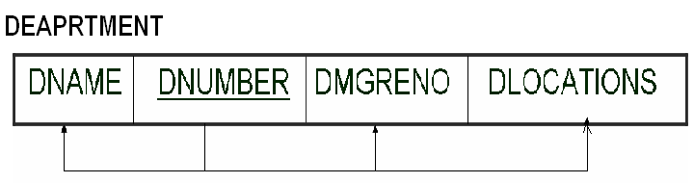
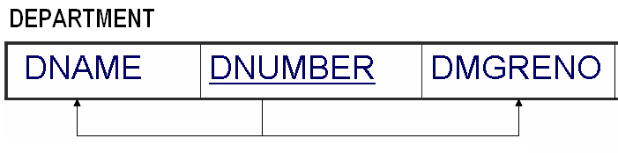
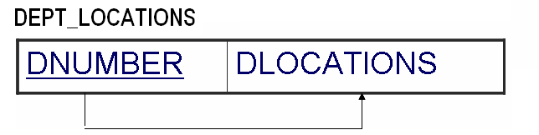
First Normal Form (first technique: best approach)

Slide 76
First Normal Form (second technique)
2. Expand the key so that there will be a separate tuple in the original DEPARTMENT for each location of a DEPARTMENT.
Then Primary Key becomes {DNUMBER, DLOCATION} and redundancy is introduced.

Slide 77
1NF version of same relation with redundancy
DNAME | DNUMBER | DMGRENO | DLOCATIONS
MCA | 1 | 22222 | Delhi
CS | 2 | 11111 | Bangalore
IS | 3 | 33333 | Hyderabad
MCA | 1 | 22222 | Pune
MCA | 1 | 22222 | Bangalore

Slide 78
First Normal Form (third technique)
Replace the DLOCATIONS attribute by two atomic attributes :
DLOCATION1
DLOCATION2
If a maximum number of values is known for the attributes:
for example , if it is known that at most two locations can exist for a department
It leads to introduction of more NULL values.

Slide 79
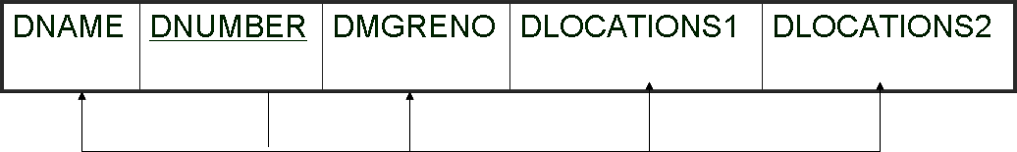
1NF version of same relation with more nulls

Slide 80
First Normal Form
First technique is generally considered to be best.
First normal form also disallows multivalued attributes that are themselves composite, which are called nested relations because each tuple can have a relation within it.
To normalize a relation into 1NF, nested relation attributes are removed and a new relation with the primary key of other new relation, is created.

Slide 81
Normalizing nested relations into 1NF
SSN
ENAME
PROJS
PNUMBER
HOURS
Relation with nested relation
SSN
ENAME
PNUMBER
HOURS
11111
Ram
1
2
78
87
22222
Mina
3
2
45
54

Slide 82
1 NF
EMPLOEE
SSN
ENAME
Primary Key: SSN
EMP_PRJ
SSN
PNUMBER
HOURS
Primary Key: {SSN, PNUMBER}

Slide 83
Second Normal From
Second normal form (2NF) is based on the concept of full functional dependency .
full functional dependency
partial dependency
Definition : A relation schema R is in 2NF if every nonprime attribute A in R is fully functionally dependent on the primary key.

Slide 84
Second Normal From
A functional dependency X → Y is a full functional dependency, if removal of any attribute A from X means dependency does not hold any more.
For any attribute A Є X, (X – {A}) does not functionally determine Y.
(X – {A}) → Y is partial dependency

Slide 85
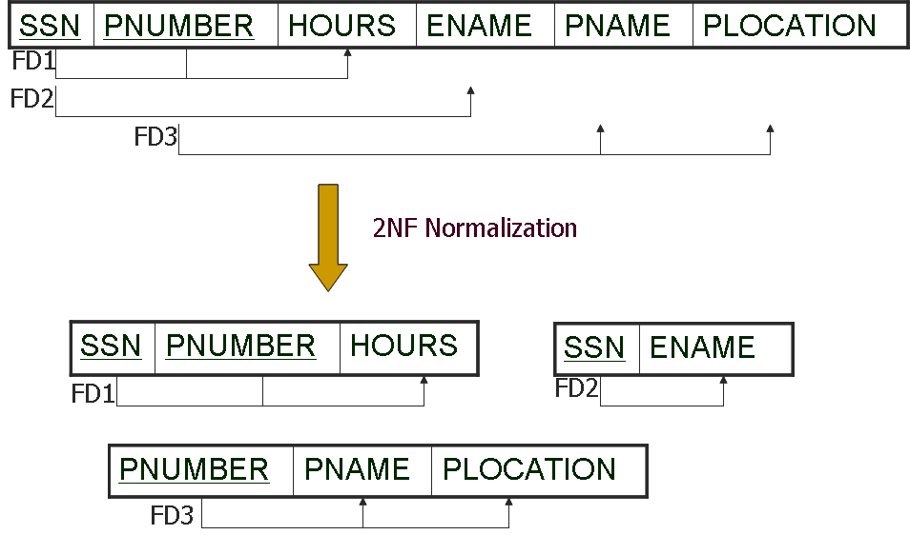
Second Normal From

Slide 86
Second Normal From
{SSN, PNUMBER} → HOURS is a full FD since
neither SSN → HOURS
nor PNUMBER → HOURS hold
{SSN, PNUMBER} → ENAME is not a full FD (it is called a partial dependency ) since
SSN → ENAME holds
{SSN, PNUMBER} →PNAME, PLOCATION is not a full FD (it is called a partial dependency ) since
PNUMBER →PNAME, PLOCATION

Slide 87
Second Normal From
If Primary Key contains single attribute, the test need not be applied.

Slide 88
Third normal form(3NF)
Third normal form(3NF) is based on the concept of transitive dependency.
A functional dependency X→Y in a relation schema R is transitive dependency if there is a set of attributes Z that is neither a candidate key nor a subset of any key of R and both X→Z and Z→Y hold.

Slide 89
Third normal form(3NF)
Definition: According to Codd’s original definition, a relation schema R is in 3NF if it satisfies 2NF and no nonprime attribute of R is transitively dependent on the primary key.
SSN → DMGRSSN is a transitive FD since
SSN → DNUMBER and DNUMBER → DMGRSSN hold
SSN → ENAME is non-transitive

Slide 90
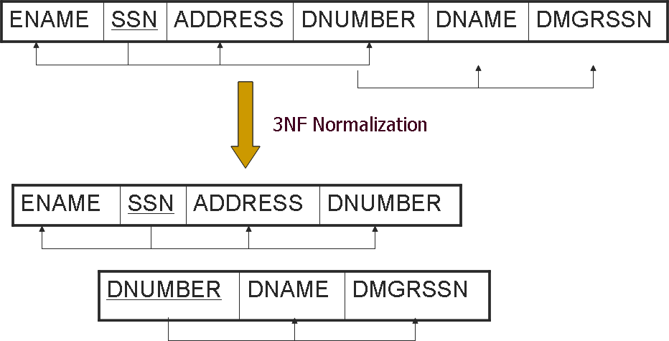
Third normal form(3NF)

Slide 91
General Definitions of Second and Third Normal Forms
NORMAL FORM | TEST | REMEDY(NORMALIZATION)
First (1NF) | Relation should have no nonatomic attributes or nested relations | Form new relations for each nonatomic attribute of nested relation
Second (2NF) | For relations where primary key contains multiple attributes , no nonkey attribute should be functionally dependent on a part of the primary key. | Decompose and set up a new relation for each partial key with its dependent attribute (s). Make sure to keep the original primary key and any attributes that are fully functionally dependent on it.
Third (3NF) | Relation should not have a nonkey attribute functionally determined by another nonkey attribute( or by a set of nonkey attributes .) that is , there should be no transitive dependency of a nonkey attribute on the primary key. | Decompose and set up a relation that include the nonkey attribute(s) that functionally determine(s) other nonkey attribute(s).

Slide 92
General Definition of second Normal Form
The previous definitions consider the primary key only.
The following more general definitions take into account relations with multiple candidate keys.
A relation schema R is in second normal form (2NF) if every non-prime attribute A in R is fully functionally dependent on every key of R or
A relation schema R is in second normal form(2NF) if every nonprime attribute A in R is not partially dependent on any key of R.

Slide 93
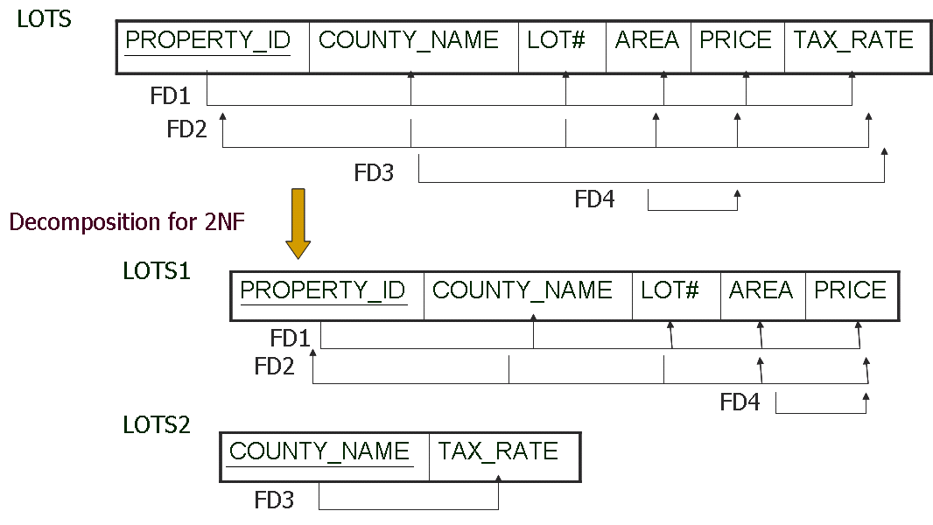
Decomposing a relation into 2NF relations (Example)

Slide 94
General definition of Third Normal Form
Superkey of relation schema R is a set of attributes S of R that contains a key of R
Definition: A relation schema R is in third normal form(3NF) if , whenever a nontrivial functional dependency X→A holds in R , either
X is a superkey of R , or
A is a prime attribute of R

Slide 95
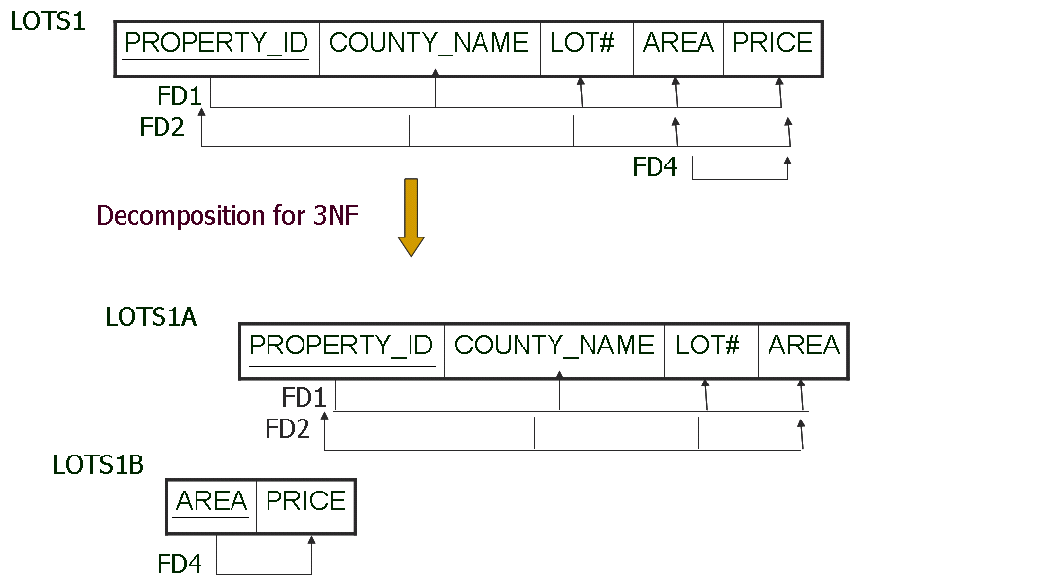
Decomposing a relation into 3NF relations (Example)

Slide 96
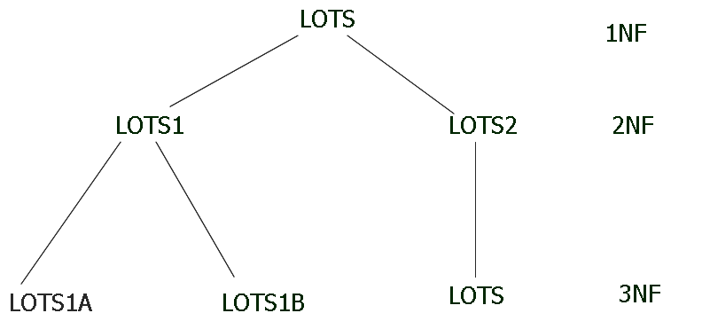
Decomposing a relation into 2NF & 3NF relations (Example)

Slide 97
Boyce-Codd Normal From
BCNF was proposed as a simpler form of 3NF, but it was found to be stricter than 3NF.
Every relation in BCNF is also in 3NF, but a relation in 3NF not necessarily be in BCNF.
A relation schema R is in BCNF if whenever a nontrival functional dependency X → A holds in R, then X is a superkey of R.

Slide 98
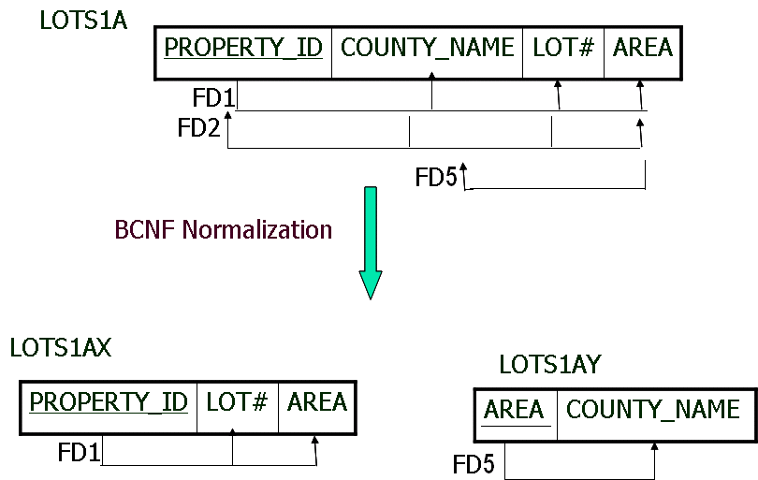
Decomposing a relation into BCNF relations (Example)

Slide 99
A relation TEACH that is in 3NF but not in BCNF
Two FDs exist in the relation TEACH:
fd1: { student, course} → instructor
fd2: instructor → course
{student, course} is a candidate key for this relation
This relation is in 3NF but not in BCNF
A relation NOT in BCNF should be decomposed so as to meet this property, while possibly forgoing the preservation of all functional dependencies in the decomposed relations.

Slide 100

A relation TEACH that is in 3NF but not in BCNF

Slide 101
A relation TEACH that is in 3NF but not in BCNF
Student
Course
Instructor
FD1
FD2
BCNF Normalization

Slide 102
A relation TEACH that is in 3NF but not in BCNF
Student
Course
Instructor
FD1
FD2
BCNF Normalization
Student
Instructor
FD1
Instructor
Course
FD2

Slide 103
A relation TEACH that is in 3NF but not in BCNF
Three possible decompositions for relation TEACH
1. {student, instructor} and {student, course}
2. {course, instructor } and {course, student}
3. {instructor, course } and {instructor, student}
All three decompositions will lose fd1.
We have to settle for sacrificing the functional dependency preservation. But we cannot sacrifice the non-additive property after decomposition.
Out of the above three, only the 3rd decomposition will not generate spurious tuples after join. (and hence has the non-additive property).

Slide 104
End of Chapter 5

